Slide 1
Solar-Powered Irrigation System Portfolio
Design and Simulation of a Solar-Powered Irrigation System
SAMSON GACHIE
February 2026
Executive Summary
This project focuses on designing a solar-powered irrigation system to pump water from a borehole using renewable energy. The system was simulated in PVsyst, and a Single Line Diagram (SLD) was developed in AutoCAD to illustrate the electrical connections and components. Key outcomes include optimal PV array sizing, pump specifications, and a feasible design suitable for sustainable irrigation.

Slide 2
System Specifications & Components
The design utilizes high-efficiency monocrystalline modules and a specialized DC pumping configuration:
PV Array: 3 x Yangzhou Tianhua 150Wp Si-mono panels (450Wp total).
Mounting: Fixed plane with an 11° tilt and South-facing orientation for optimized yield.
Pumping Unit: 600W, 64V DC submersible borehole pump.
Storage: 15,000-liter water storage tank.
Control & Protection: MPPT Universal Solar Controller and a dedicated DC Combiner Box with integrated fuses and isolators.

Slide 3
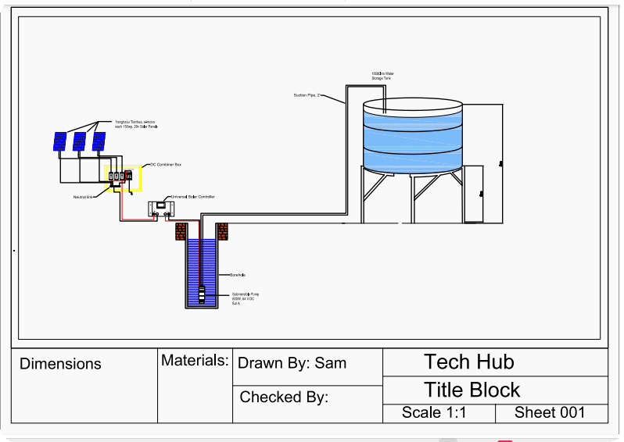
Single Line Diagram

Slide 4
Introduction•
Problem Statement: Many farmers rely on grid electricity or diesel pumps, which are costly and environmentally unfriendly. Solar energy provides a sustainable alternative.
Project Objective: To design a solar PV system capable of efficiently pumping water from a borehole for irrigation.
Scope: System design, simulation in PVsyst, and creation of SLD for electrical planning.
Components and Specifications:
PV Panels: Yanghzou Tinhua Si-mono 150w•
Number of panels: 3
Tilt angle: 11°
Orientation: South-facing
Pump: Submersible borehole pump
Flow rate: [5m³/min]
Head: [8m]
Efficiency: [46.3%]
Controller/Inverter: MPPT solar controller for optimal energy usage
Protection & Wiring: Fuses, isolators, cable sizing according to system load
•

Slide 5
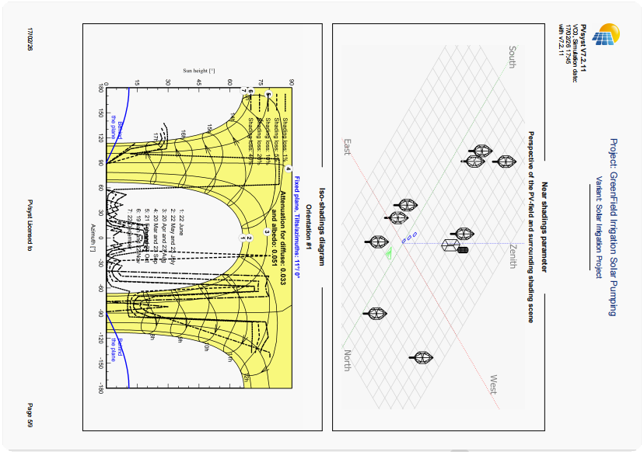
Shading Losses in PVsyst

Slide 6
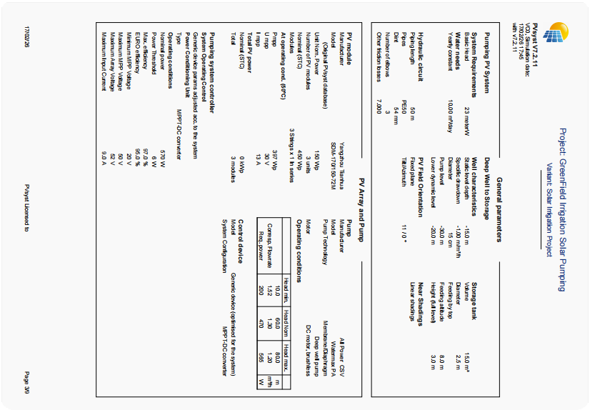
System Characteristics

Slide 7
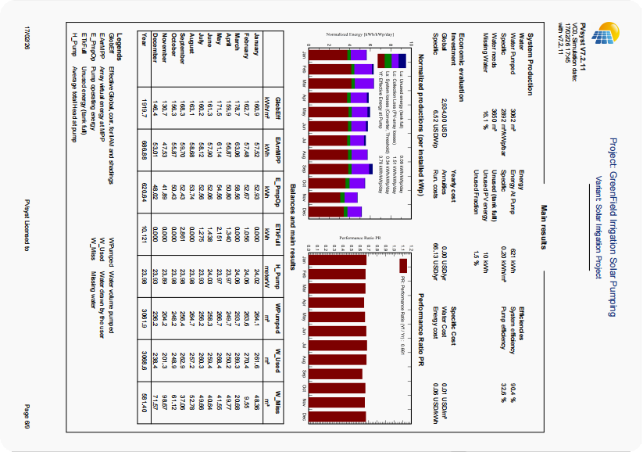
Simulation Results

Slide 8
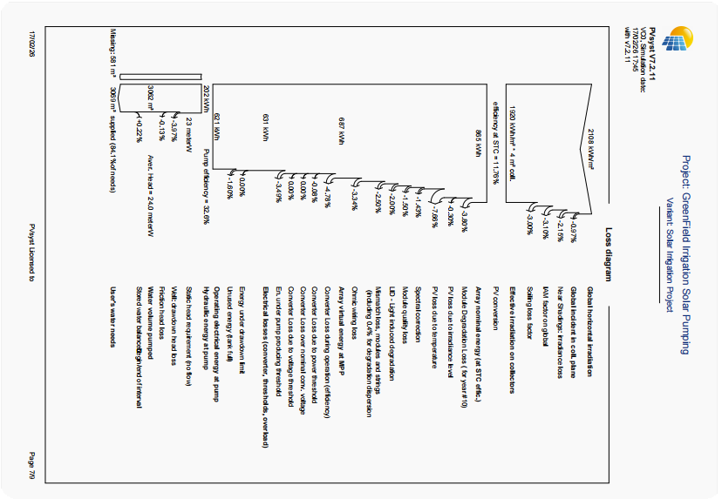
System Losses

Slide 9
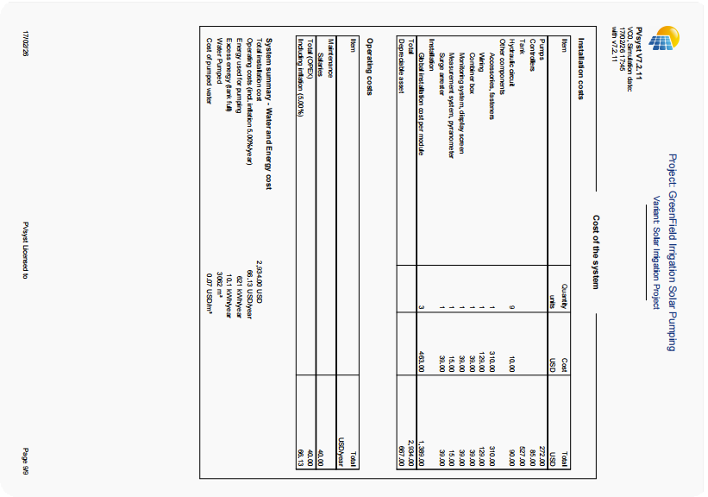
Financial Overview

Slide 10
Performance Simulation & Analysis (PVsyst)
The system was rigorously simulated to account for environmental variables and losses:
Shading Analysis: 3D scene modeling was conducted to identify near-shading losses from surrounding vegetation and structures.
Energy Yield: The system generates enough power to pump 3,062 m³ of water annually.
Efficiency Metrics: The design achieved a pump efficiency of 32.6% and a Performance Ratio (PR) of 0.661.
Loss Mapping: Detailed analysis of Ohmic wiring losses, module quality losses, and LID (Light Induced Degradation).

Slide 11
Economic & Environmental Impact
Investment: Total system installation cost is estimated at $2,934.00 USD.
Reliability: The solar solution successfully covers 84.1% of the total water needs, significantly reducing reliance on expensive diesel fuel.
Sustainability: Eliminates CO2 emissions associated with diesel pumping while providing a stable water supply for irrigation.

Slide 12
Conclusion & Recommendations
•
The designed system is technically feasible and sustainable.
Solar energy can fully power irrigation needs at the site, reducing operational costs.
Recommended for small to medium-scale farms in high solar irradiation regions.
Next steps: prototype installation, monitoring performance, and potential hybridization with batteries.
The next iteratins could include:
Battery Hybridization: To allow for pumping during low-irradiance periods or night cycles
Performance Monitoring: Remote sensing to track real-time flow rates and system health
•

